Slide 1
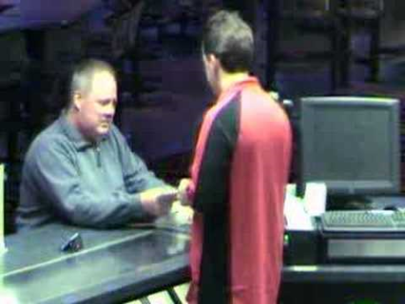
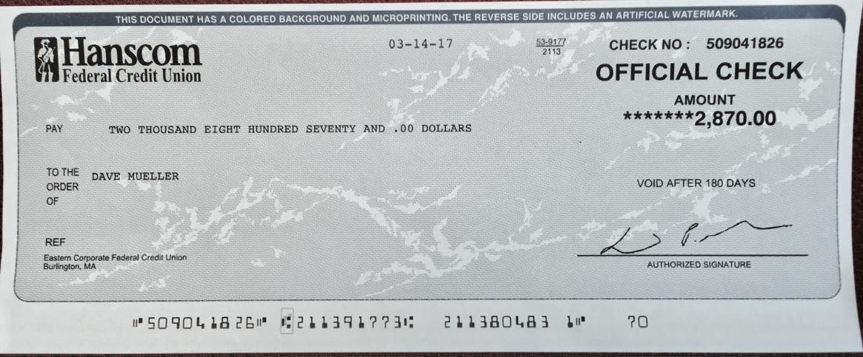
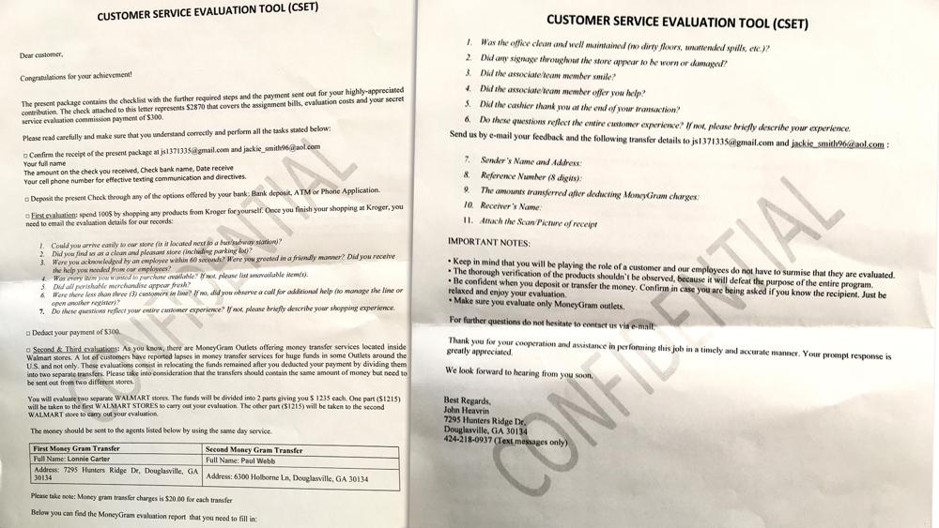
(TITLE) Fake Check Fraud
(A VIDEO FROM THE INTERNET THAT SHOWS THE SCAM YOU HAVE CHOOSEN TO DISCUSS. TELL US WHERE IT CAME FROM) WWW.FAKECHECKS.ORG
Tell us what this type of scam is… How does it work? Who is targeted?
Tell us what to do if you suspect someone is trying to deceive you with this scam.
Tell us what action steps we can take to avoid this scam. How can I protect my identity and financial information.
Be sure that your presentation includes…
(AN EXAMPLE OF THE SCAM)
The scam involves them wanting to send a check and have you deposit the funds and send a portion back to them. Of course the check is not real, but the money that's sent back to them is. One target of the scam was Dave Mueller, of Savannah, who tells WSB, he became a focus when he visited a legitimate website, the Kroger site. "I got this text from Kroger asking about me being a 'mystery shopper,'" Mueller says. "Typically I'm familiar with those scams, but it was coming from Kroger, so I confirmed it and they sent me a link. I thought that this looks legitimate, so I gave them my address." (https://www.wsbradio.com/business/consumer-advice/fake-check-scammers-target-job-seekers/ouFKXdwC7fleUsyUow4CHO/)

